Slide 1
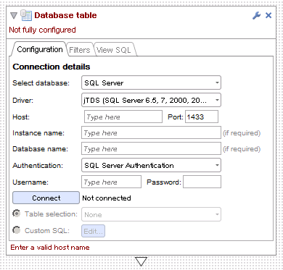
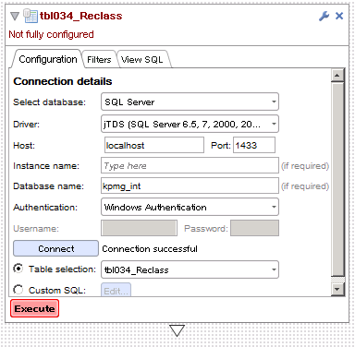
1. Add data block, set to SQL Server
2. Set host, db name etc and press connect
2.6b838 and earlier

Slide 2
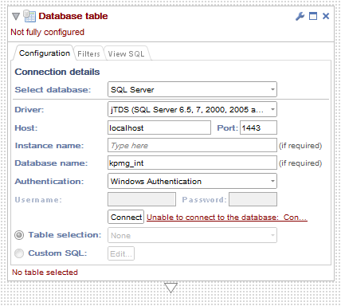
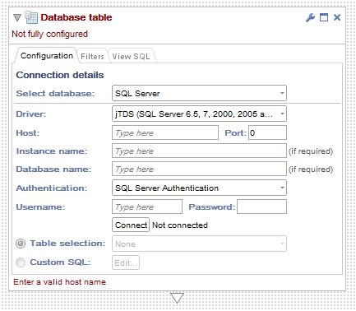
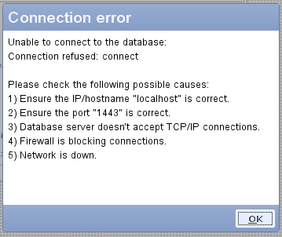
3. Add data block, change to SQL Server
4. Set parameters, click connect, get error
2.7b351

