Slide 1
Issues in the Refresh Process and Ideas to solve it
The document explain the problems I have to solve some issues in the rows refresh process.

Slide 2
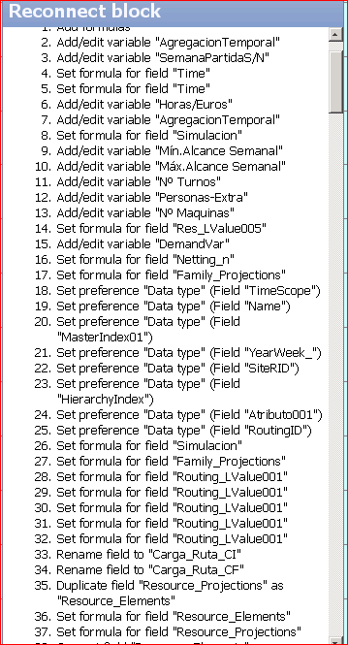
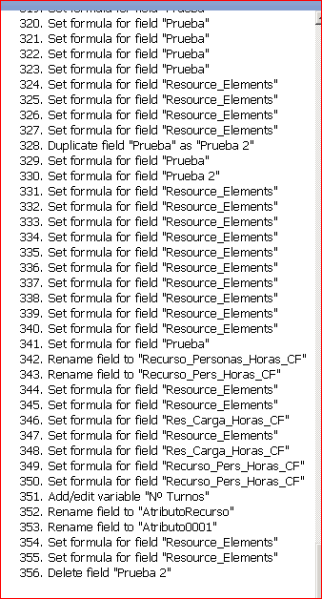
Changes made in Omnioscope Model
During the Modeling phase ther are many changes in the Omniscope field it’s a mixed of formulaes, fields and grid and graphic configuration.
It seems that Omniscope maintain it as a log of activity, giving the oportunity to undo the changes made.
It’s ok but in some cases cause heavy troubles.

Slide 3
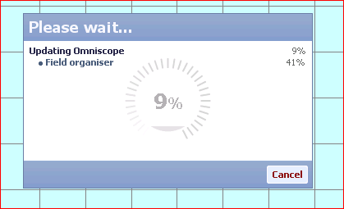
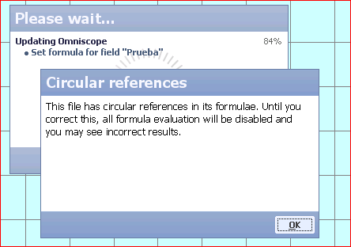
In the refresh process.
In the refresh process, sometimes the process itself reach to invalid circle relations, caused by the old formulaes saved in the structure log. Then..
It seems that the log is also a evolution process that increase the time to have the Omni scope environment ready. (Ex: The field ‘Prueba’ in the image besides, doesn’t exist in the final model.
The message alert unnecessary to the user, because in the final model there isn’t any Circular References, but stop de process and add difficulties to understand what’s happening.

Slide 4
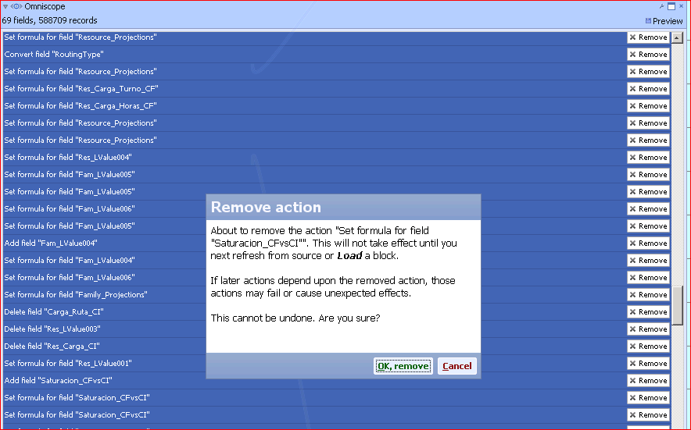
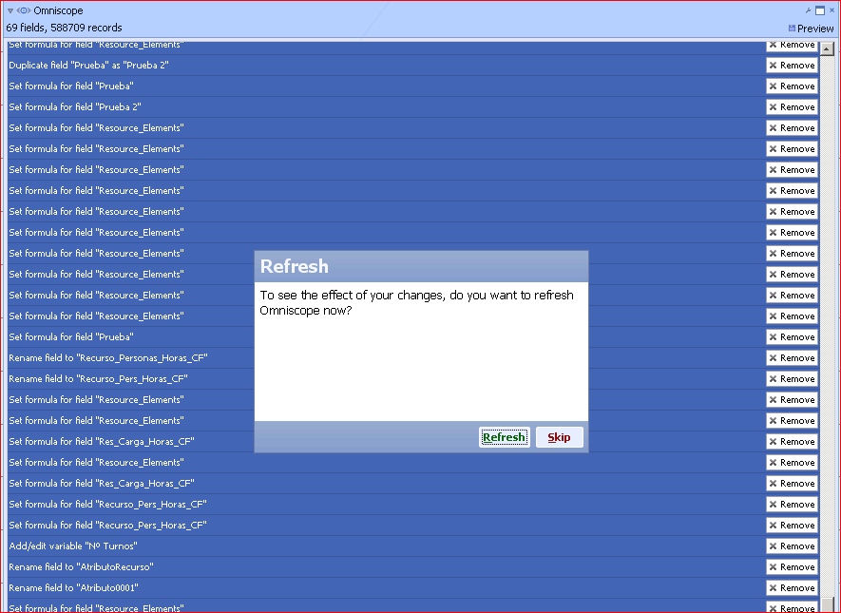
Trying to Solve the issue:
If I want to clean the formul that create the problem there are two difficults.
You don’t know what formula is, no information is shown in the message.
If you decide to clean a group of the formulas log it’s a poor eficient method with a repeated alert message in each remove action.
If you decide to clean all the log using the ‘remove all’, then the configuration of graphic and grids will be lost.

Slide 5
What I need:
For Now!!::
Conseils for a workflow, in the meantime the solution comes, I need a clear workflow to solve the issue.
Very fast refresh data process that allow the user don’t spend extra time for olders configurations or formulas of the model.
An efficient mechanism to clean selectivelly the old versions of formulaes or configurations without the risk to loose the ‘last one’.
X
Only remains the last item
X

Slide 6
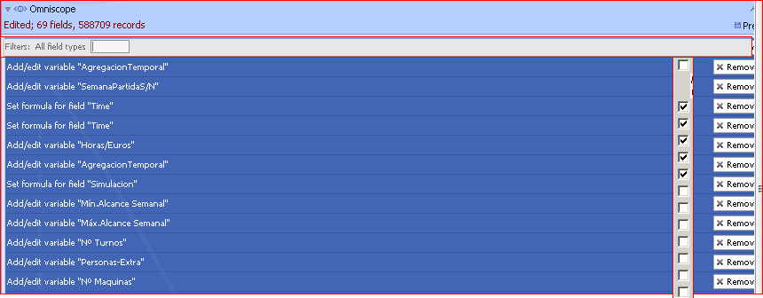
Suggestions to implement:
A button (like Commit for tabs) for clean the old versions of Omnioscope block Log without loose the final configuration of the model (formulas, fields and graphic and variables).
The posibility of not to have log of formulas.
The posibility to deactivate the warning of Circle references in the upload data process.
A more efficient method to clean groups of items log. For example:
Select field for check what i want to undo.
HeadRows order to allow user to order the log changes for theme.
Filters:
Filter for name or description like in the formula management.
Filter for type of log. Graphic , formula, grid other.
Undo until data time selection will be appreciate.

